Slide 1
FIRST AID & CPR
The Basics

Slide 2
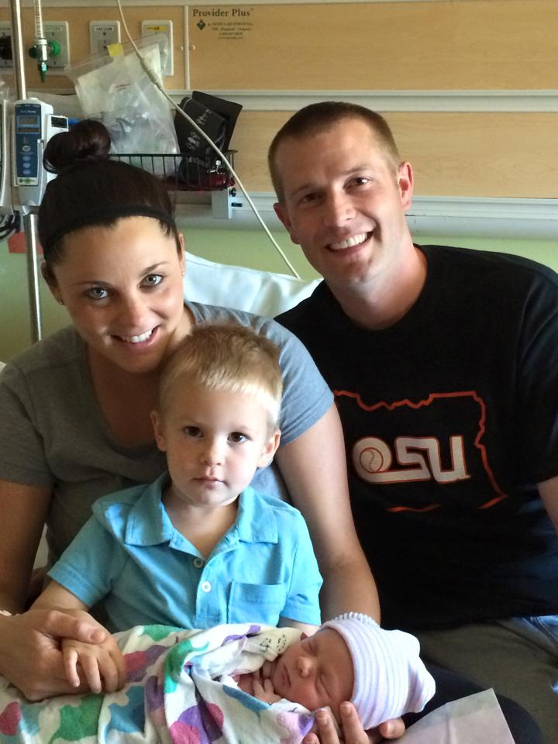
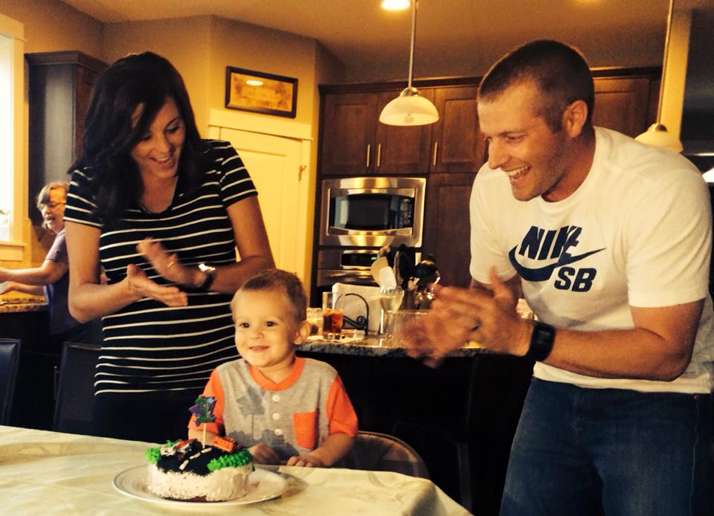
Why is it Important?
Think about someone you love…

Slide 3
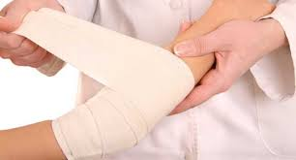
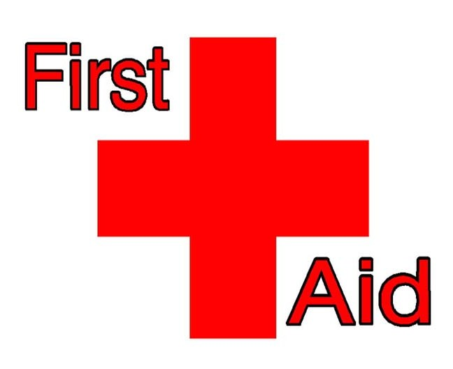
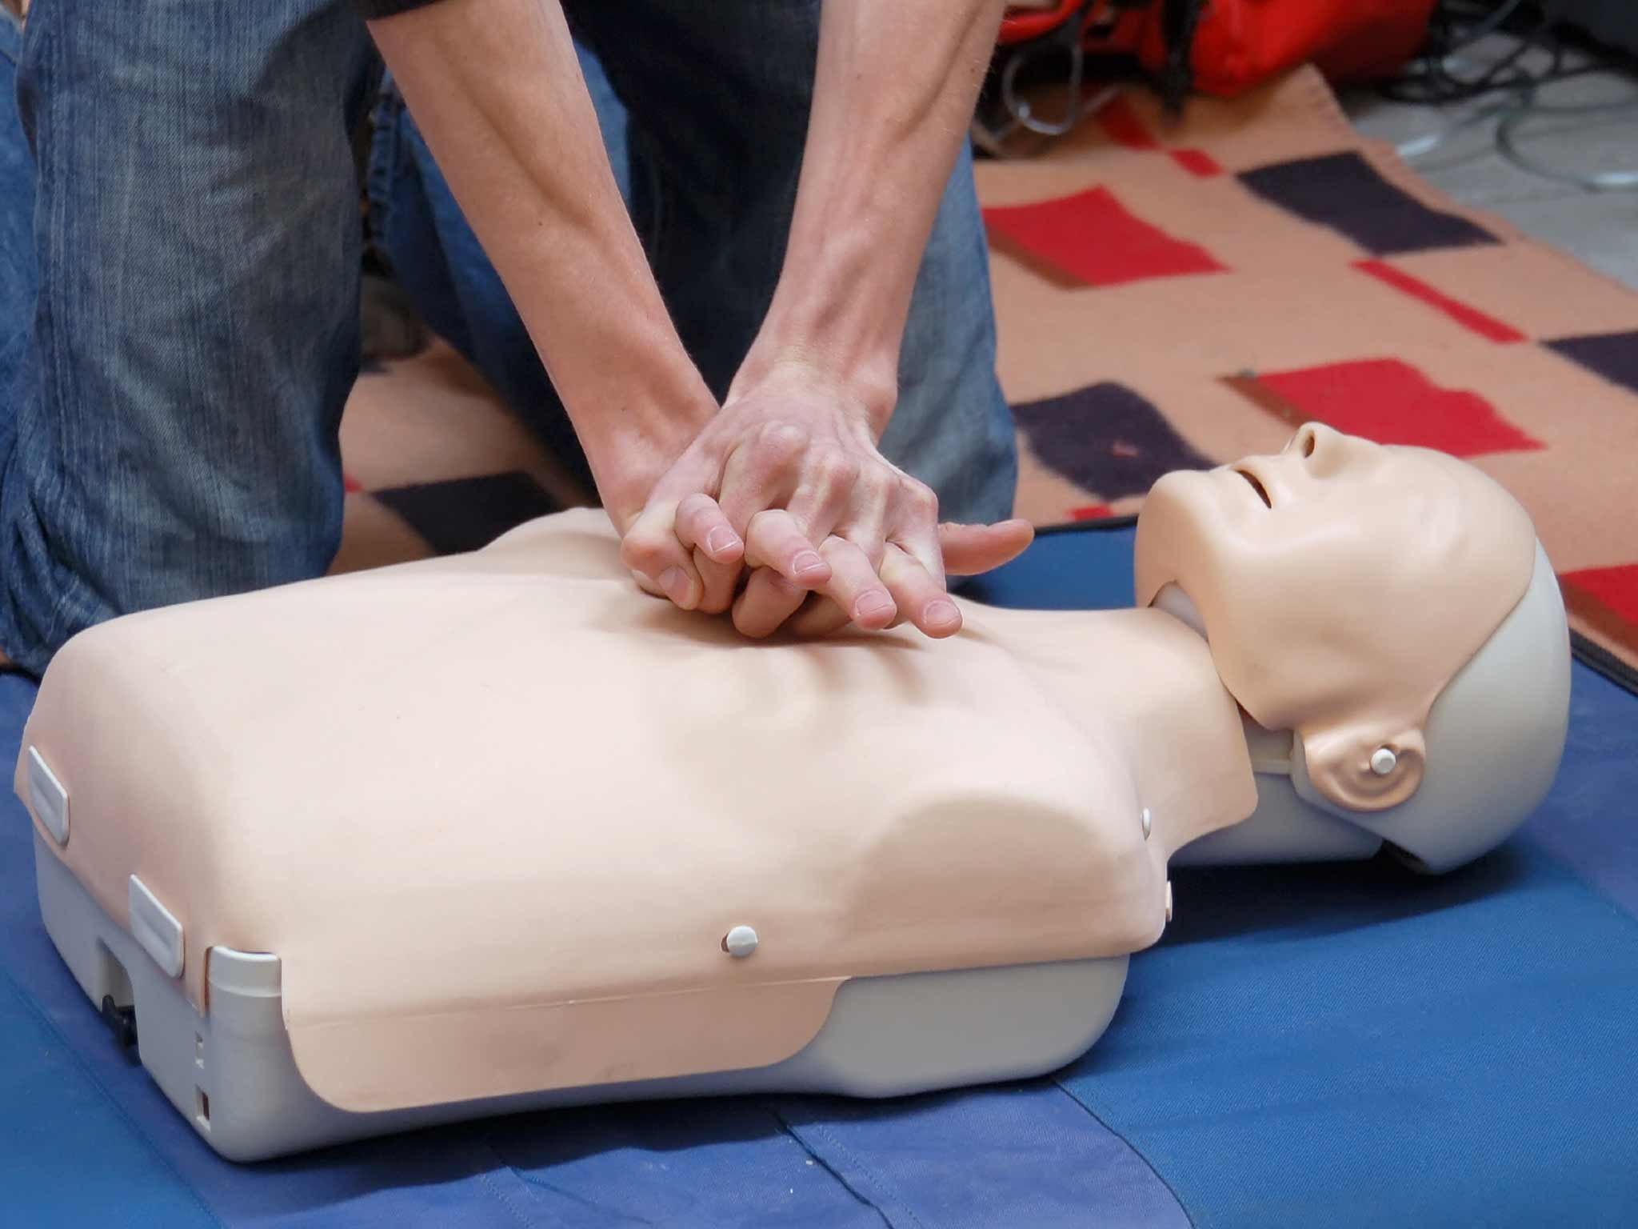
What is it?
First Aid: help given to a sick or injured person until full medical treatment is available.
American Red Cross - What would you do?
American Red Cross - Introduction

Slide 4
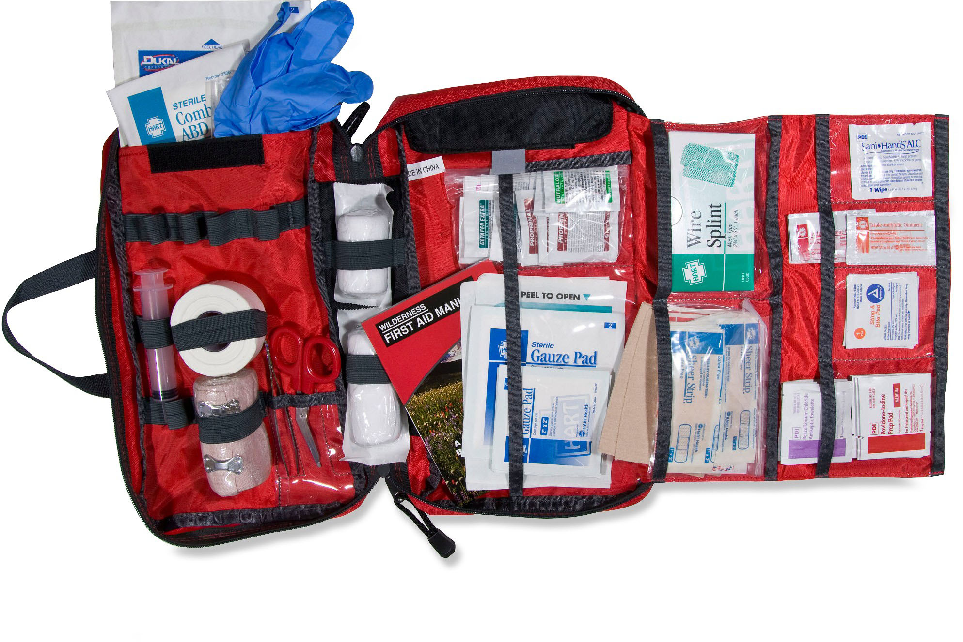
First Aid
First Aid is not all you do!
Your primary responsibility is to recognize if the situation is life threatening and call 911
You are a “lay responder”… this means that you are not professionally trained and are not obligated to help
Your responsibility if you choose to help is to help a victim with the skills that you have until professionals arrive

Slide 5
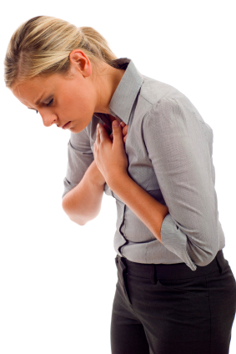
Recognizing and Responding
Emergencies are often signaled by something unusual that catches your attention
It may be hard to recognize an emergency or sudden illness in some cases – if you think something is wrong ask questions!
Unusual sights
Unusual appearance or behaviors
Unusual odors
Unusual noises

Slide 6
Deciding to Act
Sometimes, even though people recognize that an emergency has occurred they fail to act
Brainstorm a list of reasons of why this might be…

Slide 7
Deciding to Act
Barriers-Why ppl. Don’t help?
Ways to Overcome
Lack of education
Scared
“Someone else will probably do it”
Fear of doing it wrong
Being nervous about others watching
Fear of disease
Fear of lawsuit
Get trained in first aid, cardiopulmonary resuscitation (CPR) and how to use an automated external defibrillator (AED).
Avoid disease by using universal precautions
Be familiar with Good Samaritan Laws

Slide 8
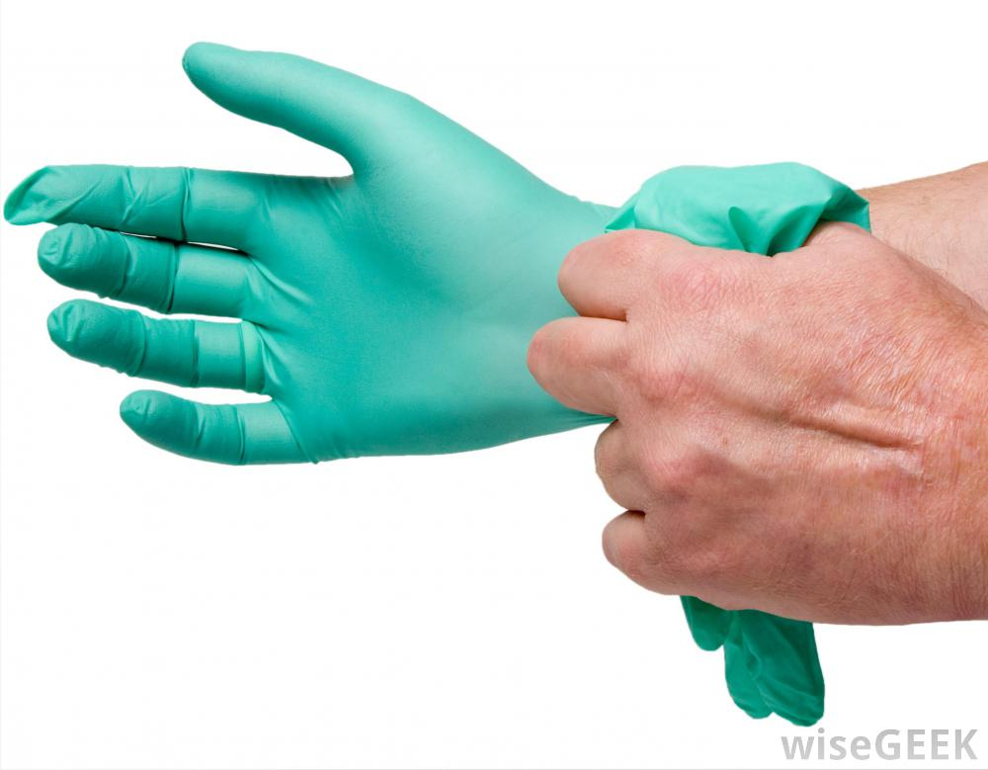
Avoiding Disease
The risk of getting a disease while giving first aid is extremely low
When you follow universal precautions you lower your risk even further…
Avoid contact with blood and other body fluids
Avoid touching objects that have blood/fluids on them
Cover any exposed personal cuts, scrapes, or sores prior to giving care
Use protective equipment like gloves or goggles
Use barriers

Slide 9
Good Samaritan Laws (Start Student Notes)
All 50 states have enacted Good Samaritan Laws that give legal protection to people who willingly give emergency care to an ill or injured person without accepting anything in return.
Each states laws are a little different – be aware of this if you travel
These laws were designed to protect you as long as you are acting in a way that a “reasonable and prudent” person would

Slide 10
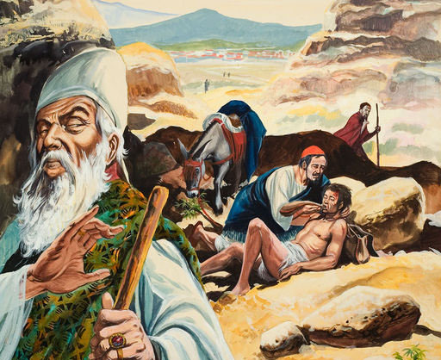
Good Samaritan Laws
Good Samaritan laws were developed to encourage people to help others
These laws require the “Good Samaritan” to…
Act in good faith
Not be purposefully reckless or negligent
Not do more than they are trained to do
Not abandon (leave) the person after beginning care

Slide 11
Check, Call, Care
Responding to an Emergency: Action Steps

Slide 12
Check
Emergency Action Steps #1

Slide 13
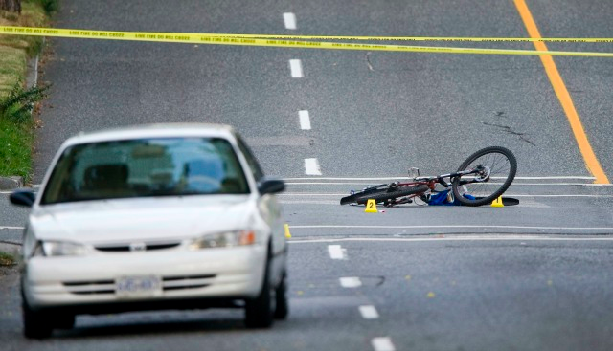
Check for Safety
First, check the scene for safety and clues as to what happened…
Is it safe?
What happened?
How many people are involved?
Is there any immediate danger?
Is anyone else available to help?

Slide 14
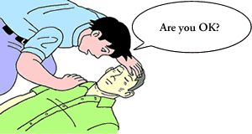
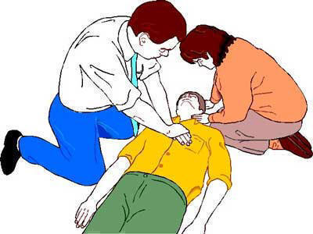
Check for Safety
Check the victim for consciousness
“Are you okay?”
Check for other life threatening conditions
Severe bleeding
Difficulty breathing
No signs of circulation

Slide 15
Checking a Conscious Victim
Collect as much information as possible from victims while they are conscious
Do you have any allergies
Do you have any medical conditions or taking any medicines
When did you last eat or drink anything
What is your name
What happened
Do you feel pain or discomfort
You must obtain consent to help a conscious victim
Provide the victim your name
State your level of training
Ask permission to help
Let the victim know what you are going to do

Slide 16
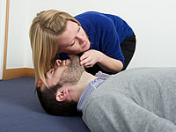
Checking an Unconscious Victim
If the victim is unconscious (they aren’t responding when you ask “are you okay?”) look, listen and feel for signs of breathing.
Consent is implied
If it is a life threatening condition, call 911 right away!
American Red Cross – Checking an Unconscious Victim

Slide 17
Checking Adults
Adults are checked from head to toe
Tell the person to not move any body part that hurts
Look for cuts, bruises, bleeding, etc. as you go along
Notice how the skin looks and feels – note if it is abnormal
Feel the persons forehead with the back of your hand for temperature and moisture
Look over body starting with head, scanning to torso, arms and hands, then legs and feet
Watch for signals and sounds of pain
When the check is complete have the victim rest comfortably while you care for conditions or call for help
Checking a Conscious Adult

Slide 18
Checking a Child or Infant
First observe the child before touching them
Get at eye level with the child
Talk slowly and in a friendly manner
Use simple words
Ask questions that the child can answer easily
When you begin your check, begin toe to head
This gives provides an opportunity to gain trust
American Red Cross – Playground Pandemonium
American Red Cross – Checking an Infant

Slide 19
Call
Emergency Action Steps #2

Slide 20
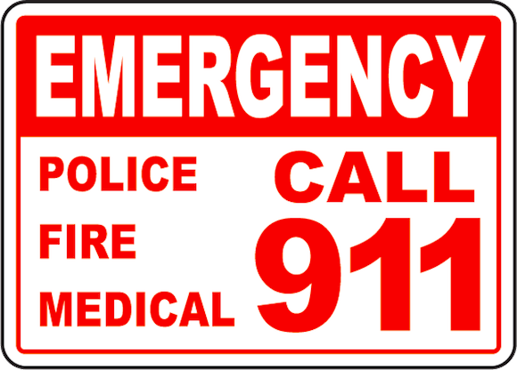
Who to Call?
When there is a life threatening situation or if you are unsure about a situation… your first job is to call 911
OR you can assign someone else to call 911 so you can begin providing immediate care
When to Call 911

Slide 21
Possible Life Threatening Conditions
Bleeding that will not stop
Breathing problems (difficulty breathing, shortness of breath)
Change in mental status (such as unusual behavior, confusion, difficulty arousing)
Chest pain
Choking
Coughing up or vomiting blood
Fainting or loss of consciousness
Feeling of committing suicide or murder
Head or spine injury
Severe or persistent vomiting
Sudden injury due to a motor vehicle accident, burns or smoke inhalation, near drowning, deep or large wound, etc.
Sudden, severe pain anywhere in the body
Sudden dizziness, weakness, or change in vision
Swallowing a poisonous substance
Upper abdominal pain or pressure

Slide 22
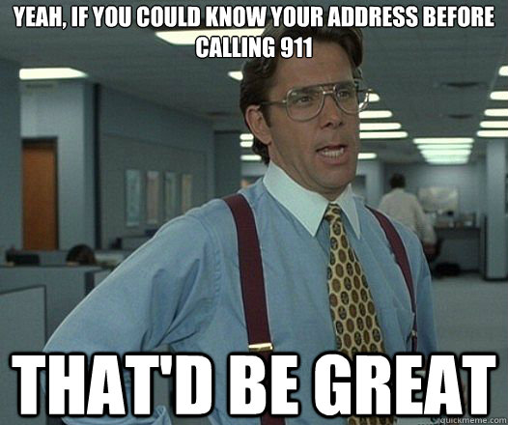
Who to Call?
If you need to call 911… make sure you know:
Where you are
What has occurred at the scene
The number of victims
The aid you are able to provide
Your name and phone number
Calling for help is the most important step you can take in an emergency to help the person in need of care

Slide 23
Care
Emergency Action Steps #3

Slide 24
Types of Care
Severe Bleeding
Open fracture
Closed fracture
Muscle Strain/Sprain
Conscious Choking
Unconscious and Breathing
Signals of a Heart Attack
Unconscious and not Breathing
Unconscious Choking

Slide 25
Emergency Action Steps
#3 Care

Slide 26
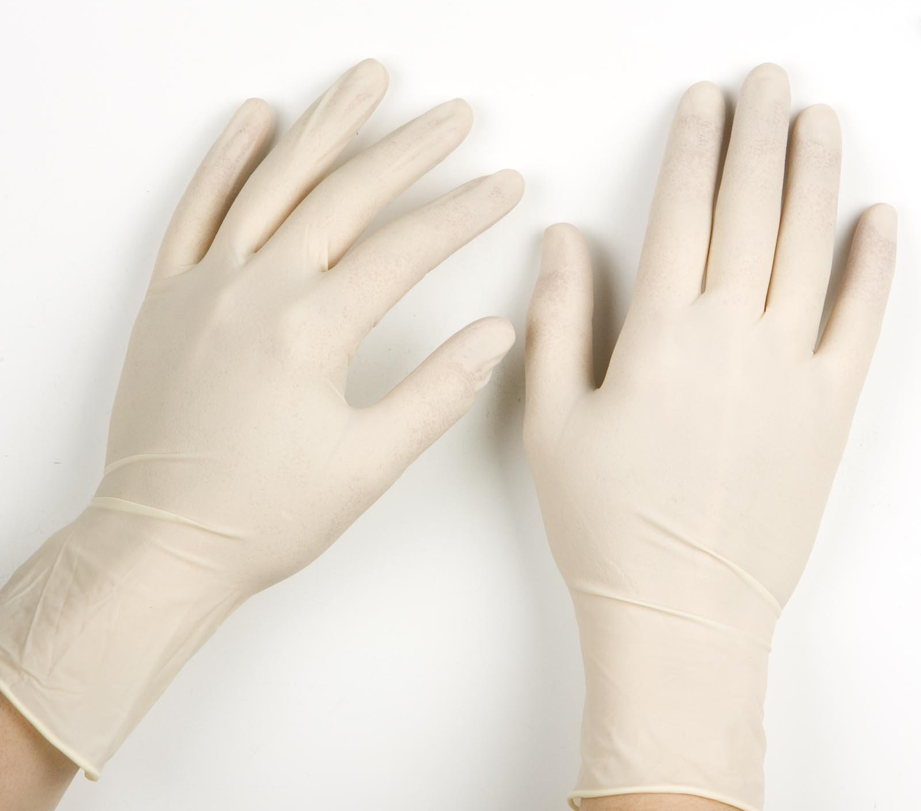
What to do…
Check: The scene then the victim
Call: 911if the situation is life threatening
Care: For the victim
Make sure to put on gloves if they are available before helping the victim
Do you need any other safety equipment? Goggles? Facemask?
Have you taken off your jewelry and covered any open wounds?

Slide 27
Severe Bleeding
Apply direct pressure to the wound using a sterile gauze pad or a clean, absorbent cloth.
If gloves are available, have the victim apply pressure on the wound.
While continuing to apply pressure, raise the wound above the victims heart (unless you suspect a fracture)… this helps slow the bleeding down.

Slide 28
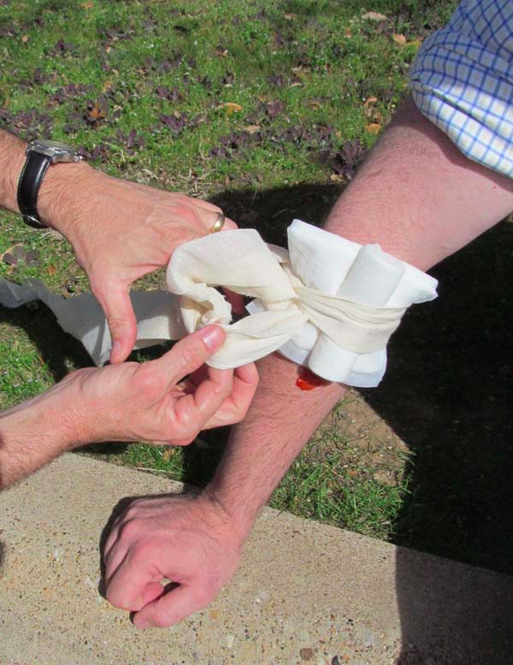
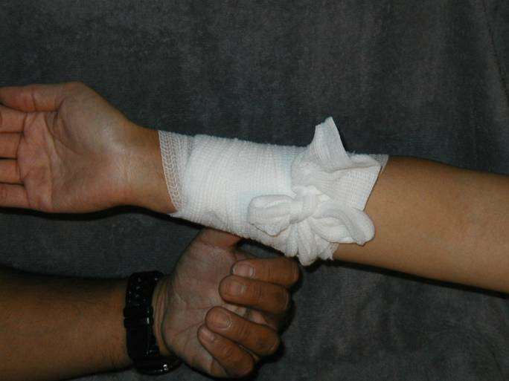
Severe Bleeding
Make a “pressure bandage” by snuggly wrapping an elastic bandage over the pad
If bleeding continues apply additional bandages on top of the existing ones
Don’t remove previous bandages!
Immobilize the injured body part after bleeding has stopped
American Red Cross – Controlling External Bleeding
Severe Bleeding

Slide 29
Open Fracture
Cut away clothing from injured area. DO NOT try to push the bone back into the skin
Apply gentle pressure with a large sterile pad to control bleeding (don’t push directly on the exposed bone)
Cover the entire area with a sterile bandage or clean cloth
If a victim needs to be moved before help arrives, apply a splint to immobilize the injured area
Open Fracture

Slide 30
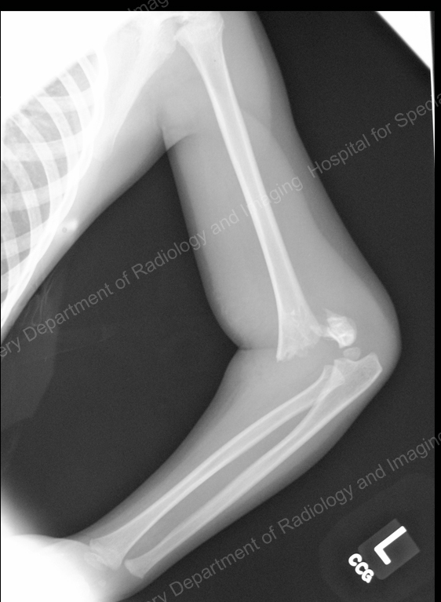
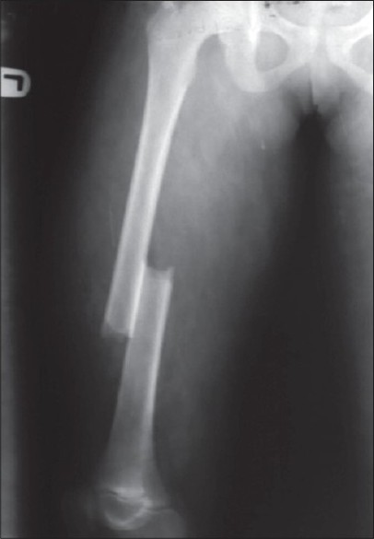
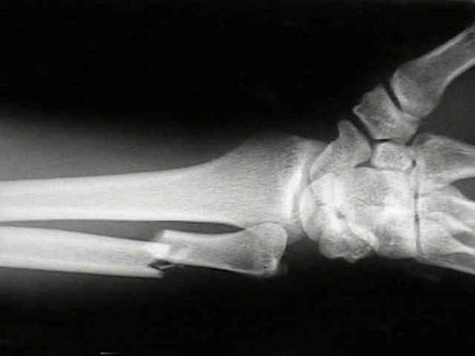
Closed Fracture
Remember – you don’t need to call 911 unless the situation is life threatening
Immobilize the injured area with a sling or splint
Keep victim still and comfortable and seek medical attention
Closed Fracture

Slide 31
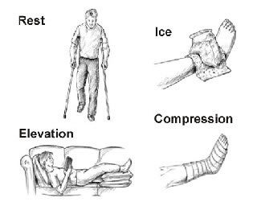
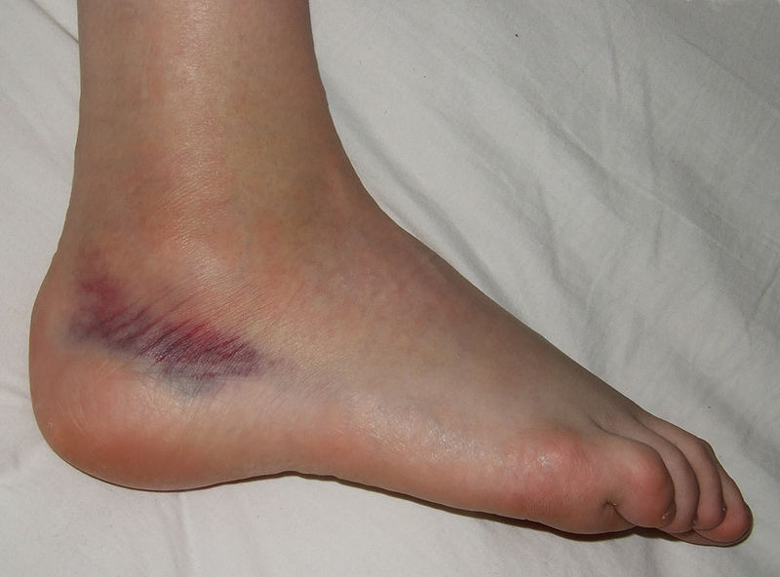
Muscle Strain/Sprain
911 is not necessary!
R – Rest the injured area and avoid using it
I – Ice (immobilize) the area within the first 24 hours to avoid swelling
C – Compress (cold) the area with elastic wrap
E – Elevate the area to prevent or reduce swelling
RICE
American Red Cross – Splinting

Slide 32
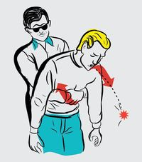
Conscious Choking
First, ask “Are you choking?”
If the victim can respond, encourage them to keep coughing.
If the victim can not respond, give them 5 back blows and perform 5 abdominal thrusts
This is the Heimlich Maneuver

Slide 33
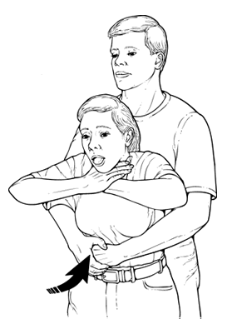
Heimlich Maneuver
Stand behind the victim
Wrap both arms around the upper part of the victim’s abdomen, just below the rib cage
Make a fist with one hand and place it (thumb inward) on the victims abdomen
Between the naval and breastbone
Grasp your fist with your other hand and pull sharply inward and upward
Continue (providing 5 back blows and 5 abdominal thrusts) until the object becomes dislodged, the victim begins to cough or breathe, or becomes unconscious
If the victim becomes unconscious, call 911 then begin CPR
American Red Cross – Conscious Choking
American Red Cross – Conscious Choking Infant

Slide 34
Unconscious and Breathing
Put the victim in the recovery position on his or her side and continue to monitor until EMS arrives

Slide 35
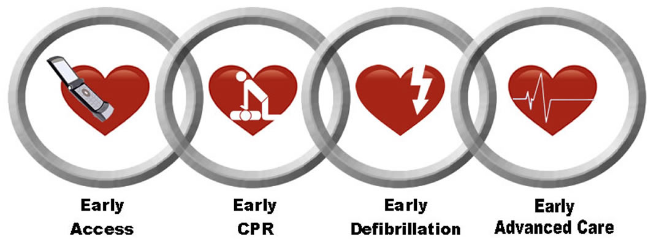
Cardiac Chain of Survival

Slide 36
Early Access
Recognize the sudden cardiac arrest emergency and call 911. Recognizing the warning signs of sudden cardiac arrest is vital in treating it successfully.
Unresponsiveness
Loss of consciousness
Lack of pulse
No breathing
An immediate call to 911 helps ensure that an advanced life support (ALS) response team will get to the victim more quickly.

Slide 37
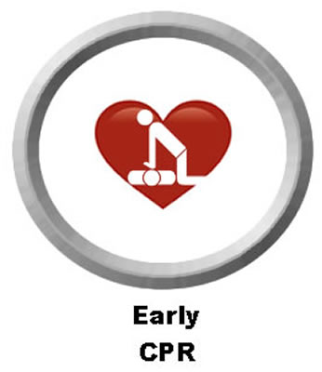
Early CPR
Providing CPR (Cardiopulmonary Resuscitation) compressions and breaths keeps oxygenated blood flowing through the heart and brain (the body’s most vital organs).
Early CPR increases the chances of survival but it alone cannot save an SCA victim.
If the responder has not been CPR certified, they may be able to receive assistance from the 911 emergency dispatcher.
Dispatchers in many parts of the country are trained to coach callers through the basic steps of CPR. Remember, CPR should be started immediately!

Slide 38
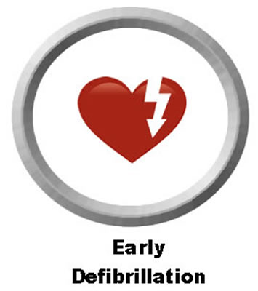
Early Defibrillation
Defibrillation is the only way to stop sudden cardiac arrest.
When SCA occurs, the heart must be restarted by an electrical shock. Outside a hospital setting, the only way to restart the heart is by using an automated external defibrillator (AED).
Having one nearby or on the emergency vehicle when it arrives is vital. When an AED is used and electrodes are placed on the victim’s chest, electricity flows from the electrodes through the chest to the heart. For each minute that passes between collapse and defibrillation, SCA survival rates can decrease from seven to ten percent. Responders should use an AED as soon as possible to increase the chance of survival.
American Red Cross – Using an AED

Slide 39
Early Advanced Care
Advanced care, after using the AED, is given to the patient by paramedics and other highly trained medical personnel on scene and when the SCA victim is being transported to the hospital.
Advanced care is necessary to help maintain a normal heart rhythm after successful defibrillation.

Slide 40
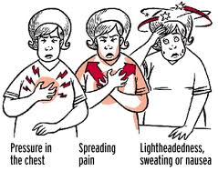
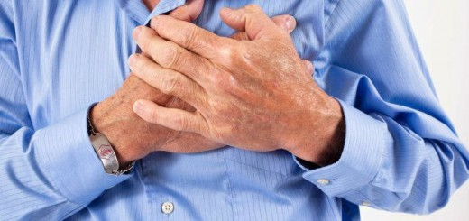
Signals of a Heart Attack
Chest pain or pressure
Pain spreading to the shoulders, neck, jaw, stomach, or arms
Nausea or vomiting
Dizziness or light-headedness
Pale, grayish, or bluish skin
Sweating
Denial of symptoms
Discovery - Heart Attack

